Slide 1

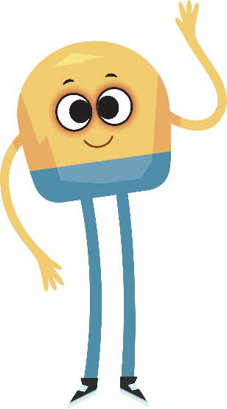

Unit 4: Week 2
Grade K

Slide 2
Copyright © Savvas Learning Company LLC. All Rights Reserved.
This publication is protected by copyright, and permission should be obtained from the publisher prior to any prohibited reproduction, storage in a retrieval system, or transmission in any form or by any means, electronic, mechanical, photocopying, recording, or otherwise. For information regarding permissions, request forms, and the appropriate contacts within the Savvas Learning Company Rights Management group, please send your query to:
Savvas Learning Company LLC, 15 East Midland Avenue, Paramus, NJ 07652
or
k12learningpermissions@savvas.com
myView Literacy® is an exclusive trademark of Savvas Learning Company LLC in the U.S. and/or other countries.

Slide 3

Lesson 1

Slide 4
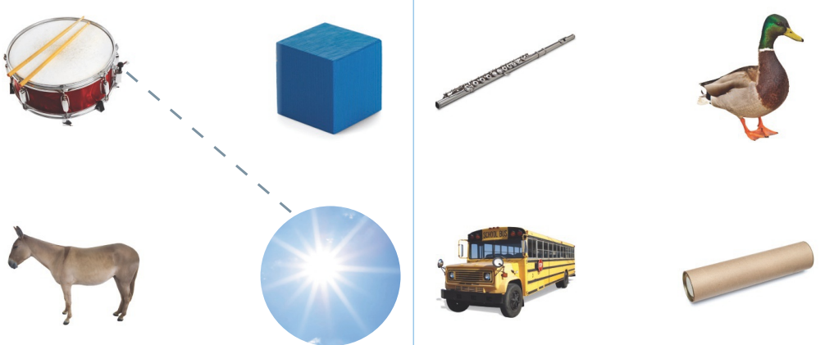
Page 54
Phonological Awareness
Notes:
Tell students that today they will learn a new sound. Listen carefully as I say the sound: /ū/ /ū/ /ū/. The sound /ū/ is made by moving your lips forward slightly and saying the sound. Show students how to make the sound /ū/. Review how to make the sound /u/ by opening your mouth slightly and saying the sound. Have students practice making the sounds /ū/ and /u/.
Have students turn to p. 54 in the Student Interactive. Tell them that they will be drawing lines to connect pictures with the same middle sound. Point to the picture of the drum. Listen to the sounds in this word: /dr/ /u/ /m/. The word drum has the sound /u/ in the middle. Have students name the other pictures and complete the activity.

Slide 5

Phonics
cube
u
u_e
Notes:
Hold up the mug Picture Card. Let’s say the word mug: /m/ /u/ /g/. Which letter spells the sound /u/? Turn the card over and point to the word. Have students identify that u spells the sound /u/ in mug.
Write the word cube on the board and draw a picture of a cube. Say the sounds as you point to each letter. This word is cube: /k/ /ū/ /b/. The sound /ū/ is spelled with the vowel pattern u_e.
Write u and u_e on the board. Tell students that you will say words that have the sound /u/ spelled u or the sound /ū/ spelled u_e. They should tell you to write the word on the board under u if the vowel sound is /u/, and under u_e if the vowel sound is /ū/. Use the following words: tub, fun, cube, bun, mule, tune.

Slide 6
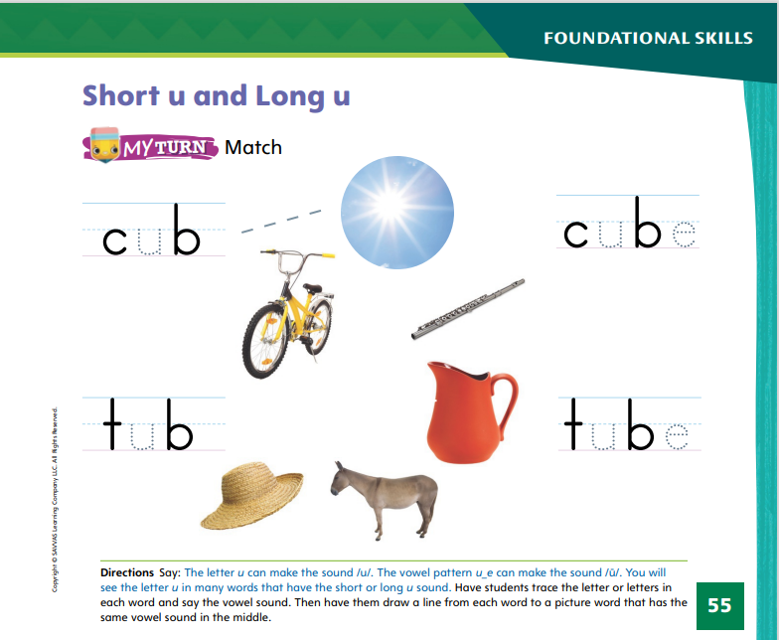
Page 55
Phonics
Turn to page 55 in your Student Interactive.
Notes:
Have students look at p. 55 in the Student Interactive. Trace the letter u in the first word. This word is cub: /k/ /u/ /b/. Now we will draw a line from the word cub to a picture that has the same middle sound. Have students complete the activity.

Slide 7
High-Frequency Words
pretty
all
now
Notes:
Display the high-frequency words pretty, all, and now.
Point to the word pretty and read it.
Have students point to the word pretty and read it.
Repeat for all and now.

Slide 8
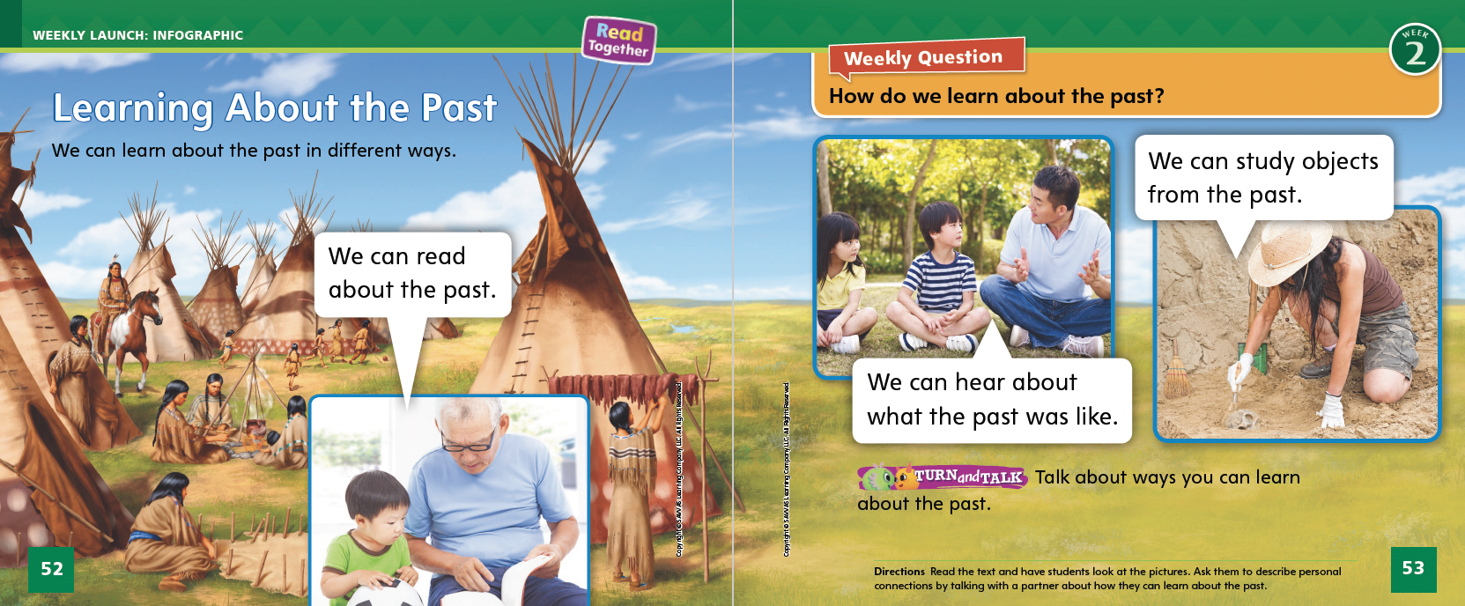
Page 52, 53
Interact with Sources
Talk about ways you can learn about the past.
Notes:
Ask students to remember the Unit’s Essential Question: What can we learn from the past? Then point out the Weekly Question: How do we learn about the past? Explain that there are different ways that people can gain knowledge, or learn, from the past.
Have students turn to pp. 52–53 of the Student Interactive. Read the infographic, “Learning About the Past.” Guide the discussion about pp. 52–53 with the following prompts:
How can you learn about the past from reading?
How can you learn about the past from hearing someone talk about it?
How can you learn about the past from studying objects from the past?
Encourage students to ask questions about the infographic to clarify anything they do not understand.
Have students use the pictures and text on pp. 52–53 to describe personal connections by discussing ways they can learn about the past.
Point out the Week 2 Question: How do we learn about the past? Tell students that they just learned about different ways to learn about the past. Reading about history, listening to someone tell a story, and seeing objects in a museum are other related ways to learn about the past. Tell students that this week they will learn more about how to learn and tell about the past.

Slide 9
Listening Comprehension
Our Trip to the Beach
1. plant fell in lake
2.
3.
4.
Notes:
Tell students that they will listen to a narrative nonfiction text. Narrative nonfiction tells about actual events in the format of a story. Have students listen as you read aloud the text, “Our Trip to the Beach.” Encourage students to be active listeners by looking at you and thinking about what you are saying as you read aloud.
Read the entire text aloud without stopping for the Think Aloud callouts.
Reread the text aloud, pausing to model the Think Aloud strategies related to narrative nonfiction.
Think Aloud: After the first few paragraphs, say: This sounds like a story that could really happen. I wonder whether it is a true story or fiction.”
Think Aloud: After you reread this paragraph, say: This story tells a lot of information. I learned that some fossils are made from plants that lived long ago. I will read to learn more about fossils.”
Use the chart to help students identify the events told in the story about how a fossil is formed.

Slide 10
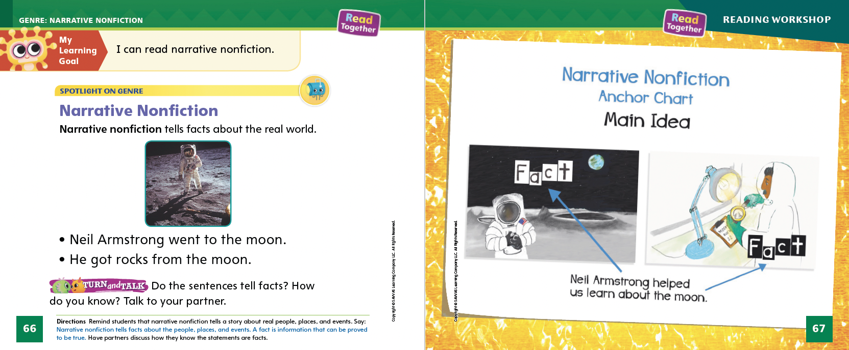
Page 66, 67
Narrative Nonfiction Qualities
Do the sentences tell facts? How do you know? Talk to your partner.
Notes:
Tell students that narrative nonfiction is a special kind of story.
Narrative nonfiction tells about real people, places, and events.
Things that are real are called facts. Facts are pieces of information that can be proved true.
Readers look for the facts in a narrative nonfiction text. Understanding what is a fact helps a reader better understand the text.
Model finding the real people, places, and events in a narrative nonfiction text. Remind students that they listened to a narrative nonfiction text, “Our Trip to the Beach.”
“Our Trip to the Beach” is about a girl who thought she found a seashell on the beach. Her mom explained that it was a fossil.
The girl’s mom then told her about how fossils were made. Her mom gave facts.
The part of the story about how fossils are formed is true and is filled with facts. That is what makes it narrative nonfiction.
Have students turn to p. 67 and look at the anchor chart. Point out that the chart shows things that really happened. Editable Anchor Chart Click Path: Table of Contents -> Reading Anchor Charts -> Unit 4 Week 2: Narrative Nonfiction Editable Reading Anchor Chart

Slide 11
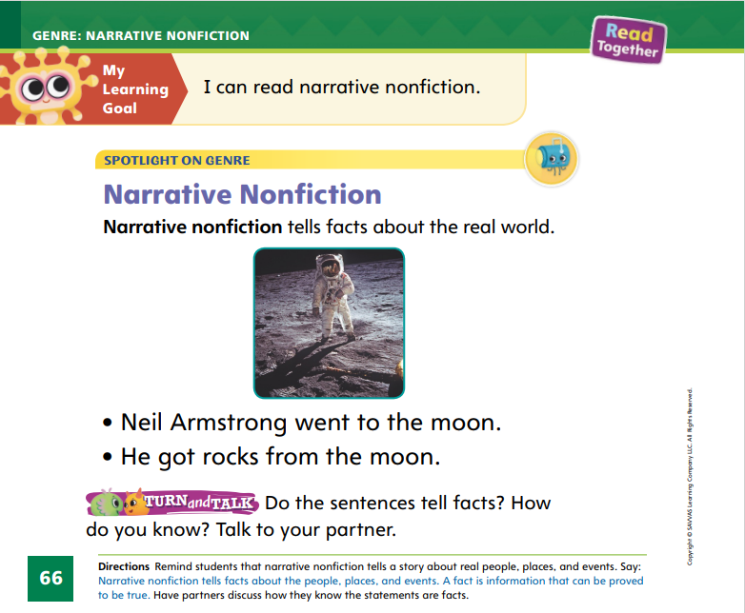

Page 66
Apply
Do the sentences tell facts?
How do you know?
Notes:
Have students use the strategies to identify the facts in narrative nonfiction.
Read aloud the sentences on p. 66 of the Student Interactive. Have students discuss with a partner whether the sentences state facts and how they know.

Slide 12
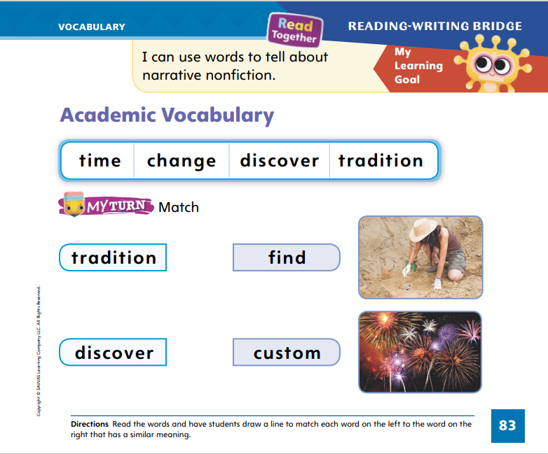
Page 83
Academic Vocabulary
Turn to page
83 in your Student Interactive and complete the activity.
Notes:
Explain to students that synonyms are words with the same or similar meanings. To tell if words are synonyms, students can:
Say the first word. What does it mean?
Say the second word. What does it mean?
Do the two words have similar meanings? If so, they are synonyms.
Tell students that learning synonyms for words can help expand their vocabulary and help them read. Say: I know that the word large means that something is big. I can find a synonym for the word large: gigantic. Gigantic is a good word to know.
Provide additional synonym pairs, such as small and tiny, wet and damp, and cool and cold. Discuss with students how the words are synonyms. Read the words in the boxes on p. 83 in the Student Interactive. Explain what tradition means. Ask students which picture might represent a tradition.
Have students complete the activity on p. 83. Provide assistance as needed.

Slide 13
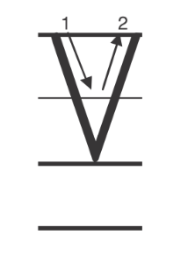
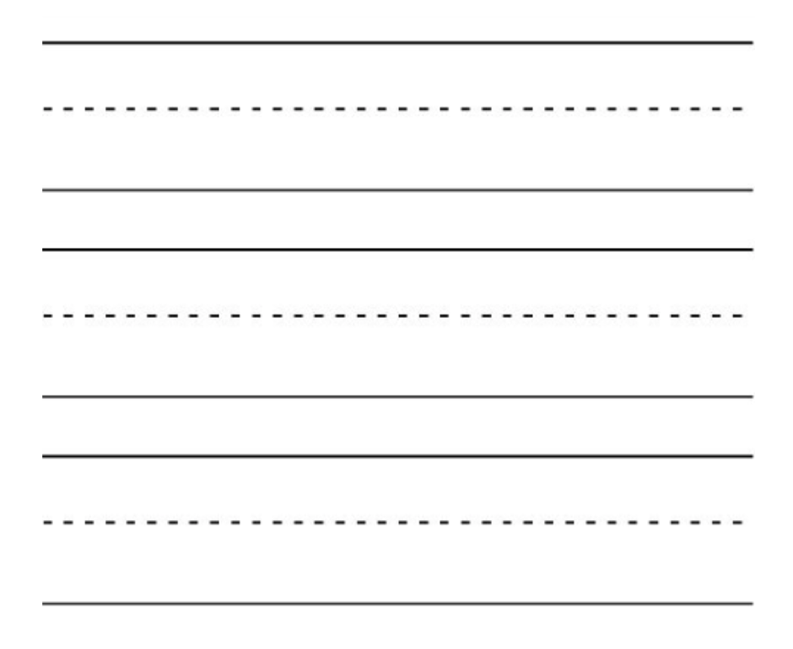
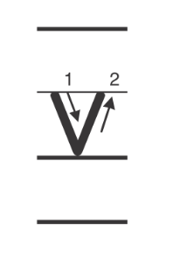
Handwriting
Notes:
Display the following uppercase and lowercase letters: Vv.
Model writing each letter, calling students’ attention to how they start at the top left, go straight down to the right, and then move straight up to the top right. Point out that the uppercase and lowercase Vv are formed the same way, but the uppercase V is taller than the lowercase v. Have them practice forming the letters in the air.
Have students use Handwriting p. 202 from the Resource Download Center to practice writing Vv. Click path: Realize -> Table of Contents -> Resource Download Center -> Handwriting Practice -> U4W1L1 Handwriting Practice

Slide 14
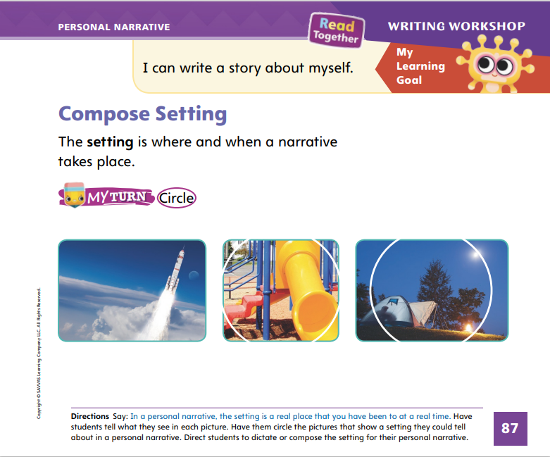
Page 87
Writing – Personal Narrative
Turn to page 87 in your Student Interactive.
Notes:
The setting of a personal narrative is the place and time in which the story takes place. Authors describe the setting of their stories using words and pictures. The setting of a personal narrative is a real place and a real time.
Show a book from the stack that includes many details about the setting in the text and pictures. Read the text aloud. Pause when you finish reading each page, and ask students if they notice any details about the setting. Explain that authors give a lot of big details and little details in the background that help the reader picture the story.
On a flipchart or board, make a stick figure drawing of yourself. Include a desk and another stick figure to represent a student. Beneath the drawing write Today I went to school. Ask students to name the setting (school, today). Then ask them what you should add to your background. Tell students to look around the classroom and suggest details for your background.
Direct students to p. 87 of the Student Interactive. Read the page aloud and have students circle the pictures of settings that they could compose in a personal narrative. Remind them that a personal narrative is a story that happened in real life, so the setting of their story should be somewhere they have been.

Slide 15

Independent Writing
Compose the setting for your personal narrative.
Share your setting with the class. Tell both the place and the time.
Notes:
After learning how to add details to a setting, students should continue writing independently. Ask them to review the personal narrative they are writing to make sure a reader can tell where and when the story takes place. Remind them that they can add details to the pictures as well as the words.
Writing Support
Modeled - Use stack texts to show setting details in drawings or pictures.
Shared - As students write, share details they could include in their setting.
Guided - Prompt students with questions about what is found in their setting.
Call on students with whom you conferred to share their settings with the class. Remind students to tell both the place and the time.

Slide 16
Spelling
Playing at the park is fun.
I need to finish my math homework now.
Please put all the books back on the shelf.
My uncle spilled juice on the rug.
He filled the cup too full.
She is nice, but her dog growled at me.
Notes:
(Note: Move the orange boxes to cover each bold spelling word before you read aloud the words and sentences.)
Read aloud the words and sentences. Have students spell each word with initial consonant blends and the two high-frequency words.
Playing at the park is fun.
I need to finish my math homework now.
Please put all the books back on the shelf.
My uncle spilled juice on the rug.
He filled the cup too full.
She is nice, but her dog growled at me.
Reveal the spelling word and have students check their work.

Slide 17
Language and Conventions
The man went to the store.
Circle the capital letter at the beginning of the sentence.
The girl _____.
Complete the sentence by adding an action part.
Notes:
Review with students that complete sentences begin with a capital letter and have a naming part and an action part. Invite volunteers to tell you complete sentences.
Display this sentence on the board: The man went to the store. Ask a student to circle the capital letter at the beginning of the sentence.
Have students work with a partner to complete the following sentence frame by adding an action part: The girl ____.

Slide 18
Lesson 2

Slide 19

Phonics
u
u_e
tub
tube
cub
cube
Notes:
Hold up the tub Picture Card. This is a picture of a tub. I hear the sound /u/ in the middle of tub. Turn the card over. The sound /u/ is spelled u in tub.
Draw a simple tube on the board. This is a picture of a tube. I hear the sound /ū/ in the middle of tube. Write the word tube on the board. The sound /ū/ in tube is spelled with the pattern u_e.
Write the vowel u and the vowel pattern u_e on the board. Have several students tell you the sound each one spells.
Write the words cub and cube on the board. Let’s read these words together. Point to each letter in cub as students identify the letter sound. What sound does c spell? What sound does u spell? What sound does b spell? Now let’s blend the sounds to read the word: /k/ /u/ /b/, cub. Continue with the word cube.

Slide 20
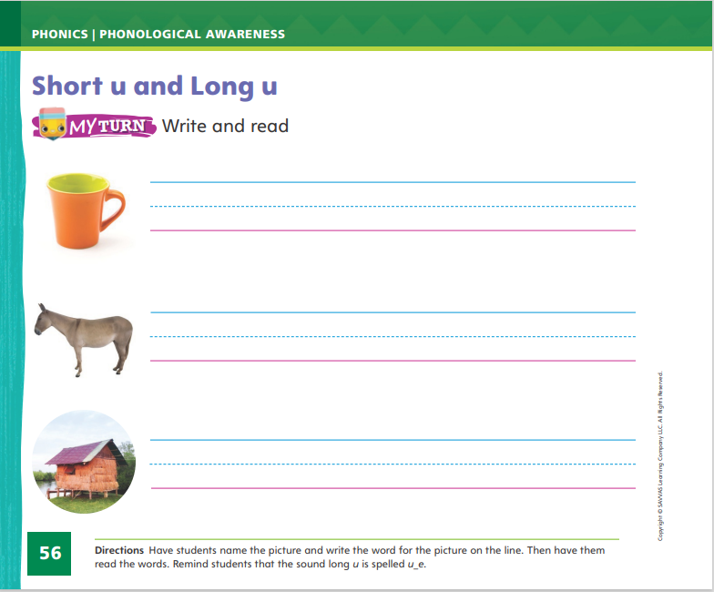
Page 56
Apply
Turn to page 56 in your Student Interactive.
Notes:
Have students complete p. 56 in the Student Interactive.

Slide 21
High-Frequency Words
pretty
all
now
Notes:
Tell students that high frequency words are words that they will hear and see over and over in texts.
Write and read the words pretty, all, and now.
Have students
read each word.
spell each word, hopping as they say each letter.

Slide 22
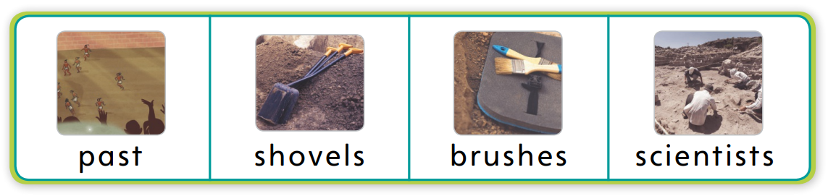
Page 68
Preview Vocabulary
Notes:
Introduce the words past, shovels, brushes, and scientists from p. 68 of the Student Interactive.
Have students share what they already know about the words. Ask questions such as: What does it mean when something happens in the past? What do you know about what scientists do? How would you use shovels or brushes?
Ask students to look for these words as you read the text.

Slide 23
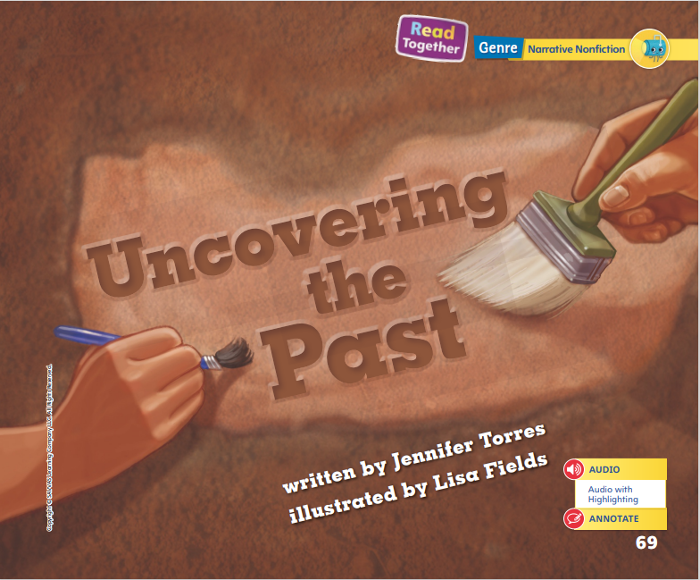
Page 69
First Read Strategies
Notes:
Discuss the First Read Strategies with students. Tell students that looking at the title and pictures before reading can help them figure out what a text will be about. Listen to the title and look at the pictures. What do you think the text will be about?
First Read Strategies
READ Read or listen to the text. During the first reading, work to understand what the text is about.
LOOK Look at the pictures to help understand the text.
ASK Generate, or ask, questions about the text to deepen understanding.
TALK Talk to a partner about the text.
Students may read the text independently, in pairs, or as a whole class. Use the First Read notes to help students connect with the text and guide their understanding.

Slide 24
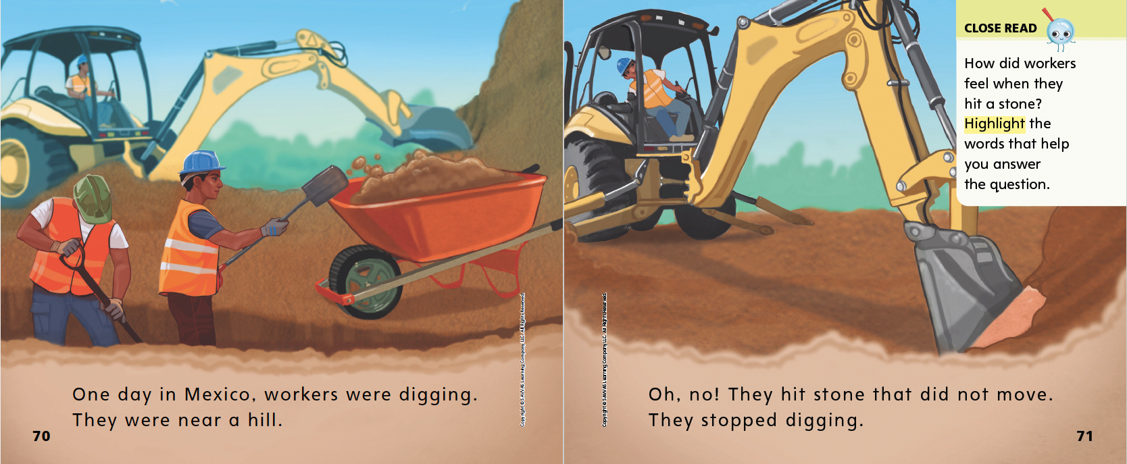

Page 70, 71
First Read – Uncovering the Past
Notes:
Read Together.
THINK ALOUD Looking at the details in the pictures can help me better understand what I read. I can see some big equipment. A worker is steering the huge shovel of the truck to dig dirt out of the ground. There are also two workers using shovels to put dirt in a wheelbarrow. They will use the wheelbarrow to carry the dirt away. Looking at the picture helps me understand how the workers are doing the work and the tools they are using.

Slide 25
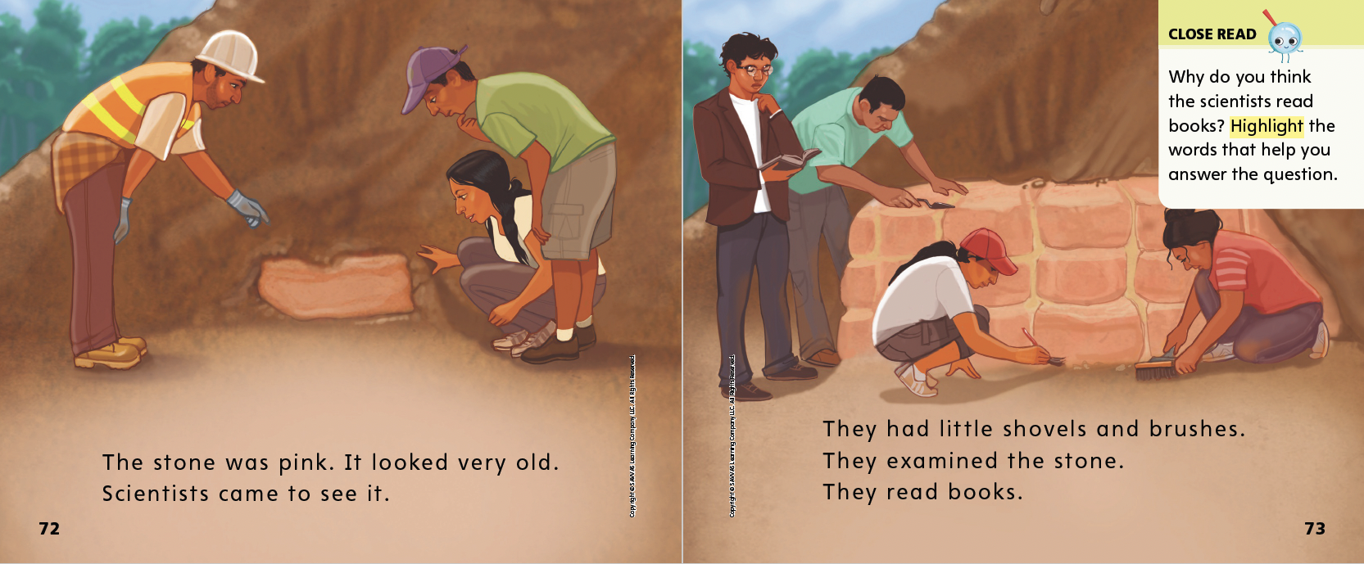
Page 72, 73
First Read – Uncovering the Past
Notes:
Read Together.

Slide 26
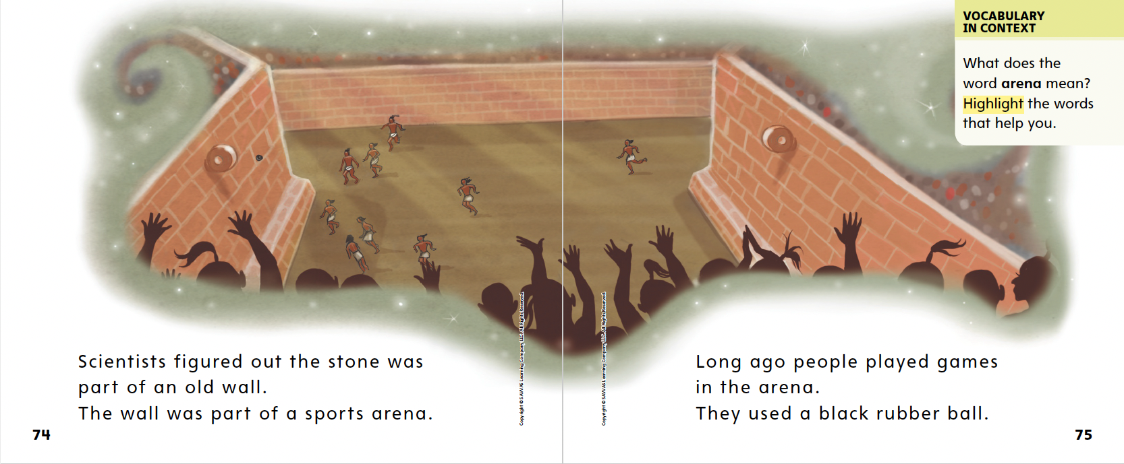
Page 74, 75
First Read – Uncovering the Past
Notes:
Read Together.
THINK ALOUD As I read, I have questions about the text and pictures. How did the scientists figure out what the wall was for? How do they know what kinds of games were played there? When I ask questions, it helps me pay closer attention as I read. It helps me understand the text better.

Slide 27
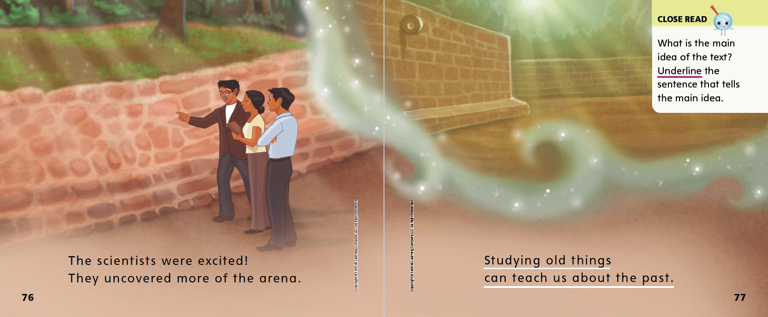
Page 76, 77
First Read – Uncovering the Past
Notes:
Read Together.

Slide 28
Respond and Analyze
Retell: Tell a partner what you found most interesting about the text.
Illustrate: Draw one of the main events in the text.
Notes:
Use these suggestions to prompt students’ initial responses to reading Uncovering the Past.
Retell Tell a partner what you found most interesting about the text.
Illustrate Events Have students illustrate one of the main events in the text. Then have partners describe the event by referring to the illustration.

Slide 29
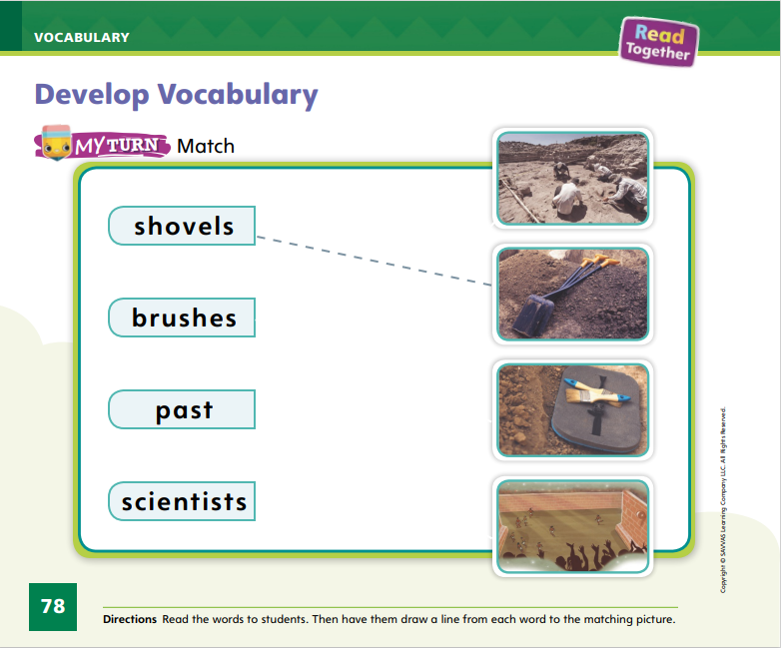
Page 78
Develop Vocabulary
Turn to page 78 in your Student Interactive and complete the activity.
Notes:
Tell students that they can often use images or illustrations to figure out or better understand the meaning of a word. The vocabulary words shovels, brushes, past, and scientists can be used to talk about the real people, places, and events in Uncovering the Past.
READ each word.
LOOK for photographs or illustrations that help you picture and understand the word.
THINK about how this word adds to the story. How does this word help show what happens in the story?
Have students turn to p. 78 in the Student Interactive. Read aloud the word shovels. Model drawing a line from the word to the picture of shovels.
Have students practice developing vocabulary by completing p. 78 of the Student Interactive.

Slide 30
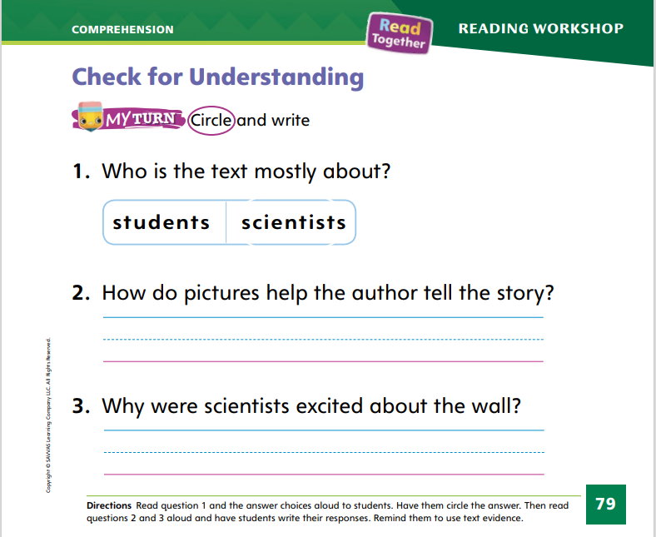
Page 79
Check for Understanding
Turn to page 79 in your Student Interactive and complete the activity.
Notes:
Have students complete the Check for Understanding on p. 79 of the Student Interactive.

Slide 31
Writing – Personal Narrative
Let’s identify the narrator in the story.
Remember to look for the words I, me, and my.
Notes:
A narrator of a personal narrative is the person or character who tells the story. The narrator tells about the characters, setting, and events of a story. In a personal narrative, the author is the narrator of the story because it is a story about his or her life.
Read the title and author name from a stack book. Tell students that the book is a personal narrative about something that happened in the author’s life. Recall that personal narratives use the words I, me, and my because the story is a true story told by the author. Explain that the author is the narrator, or the person who tells the story.
Read the stack text aloud. Prompt students to identify the narrator. Then read another stack text or review ones you read during the immersion days. Point out the author’s name on the cover and tell students that he or she is the narrator; the story in the book happened to this person. When they write their own personal narratives, they will be the narrator.

Slide 32
Independent Writing
Continue working on your narrative.
Make sure to use words like I, me, and my when you are writing.
Notes:
After this lesson, students may be able to transition into using their knowledge about narrators in their own writing. Students should write independently, making sure to use words like I, me, and my when they write their personal narratives.
Writing Support
Modeled - Write a personal narrative about an event students can relate to.
Shared - As you read a stack text, have students identify the narrator in the story.
Guided - Prompt students to think about how they would tell the story to a friend.
Ask a student with whom you have conferred if you can read a sentence from his or her personal narrative. Once you have done that, engage students in a discussion about who is the reader and who is the narrator of the story,

Slide 33
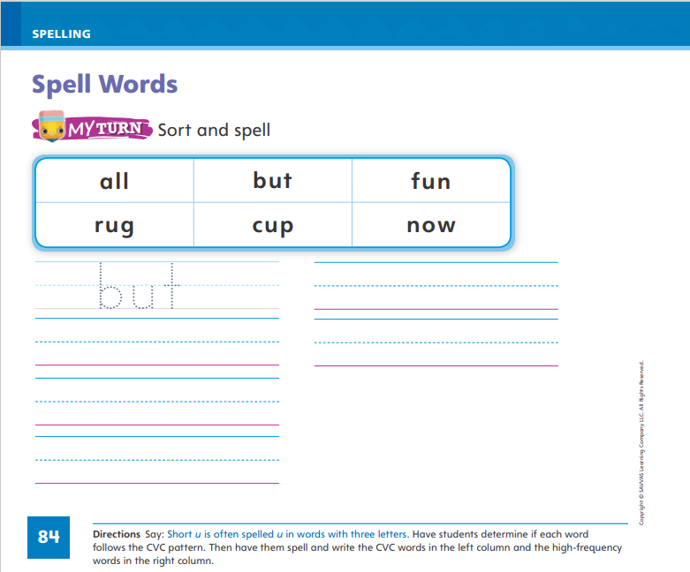
Page 84
Spelling
run
sun
tug
Turn to page 84 in your Student Interactive and complete the activity.
Notes:
Write the word run on the board. Tell students that in run, the sound /u/ is spelled with the letter u. Run also has a CVC pattern.
Write sun on the board. I see a consonant, a vowel, and another consonant, so I know the word has a CVC pattern. The vowel u has a short sound: /u/. Knowing the vowel sounds in a CVC word helps me spell words. Write tug on the board. Ask students to identify the vowel pattern. Ask what sound the letter u spells.
Have students complete the activity on p. 84 in the Student Interactive.

Slide 34
Language and Conventions
Tim baked a cake.
What kind of cake did Tim bake?
What a great cake!
With a partner, create sentences that tell, question and exclaim.
We will identify the sentences as a class.
Notes:
Answer any questions students may have about complete sentences. Then tell students that there are different kinds of sentences. Telling, or declarative, sentences end with a period. Sentences that ask questions end with a question mark. Sentences said with excitement end with an exclamation point.
Display these sentences: Tim baked a cake. What kind of cake did Tim bake? What a great cake!
Read the sentences aloud, modeling intonation for a statement, question, and exclamation. Point to the end punctuation as you read each one. Ask students to tell what the punctuation mark is at the end of each sentence and what kind of sentence it is.
Have partners create oral sentences that tell, question, and exclaim. Have students share their sentences with the class, identifying each type of sentence.

Slide 35
Lesson 3

Slide 36
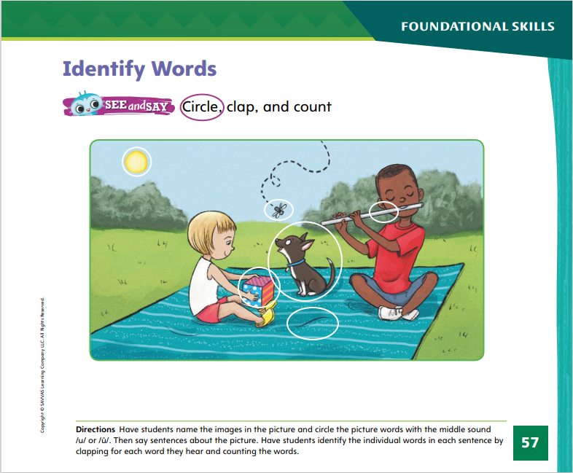
Page 57
Phonological Awareness
Turn to page 57 in your Student Interactive.
Notes:
Say: Today we are going to learn more about words. Listen to this sentence: The sun is pretty. Listen again and count the words as we clap: The sun is pretty. How many words are in the sentence?
Ask students to identify each of the words in the sentence. Have a student stand for each correct response. There are four words in the sentence: The sun is pretty. There are four students standing, one for each word.
Have students turn to p. 57 in the Student Interactive. Ask them to look for pictures of words that have the sound /u/ or /ū/. I see the sun. Does sun have the middle sound /u/ or /ū/? Yes, it has the middle sound /u/. We will circle it.
Have students find and circle other things in the picture that have the sound /u/ or /ū/. Then say sentences about the picture. Have students identify the individual words in each sentence by clapping for each word they hear and counting the words.

Slide 37
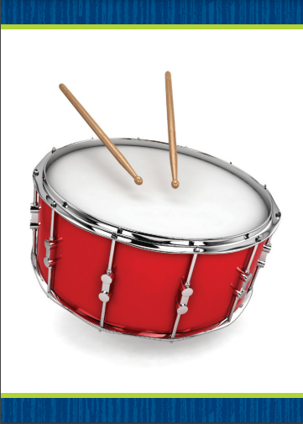

Page 58
Phonics
Turn to page 58 in your Student Interactive and complete the activity.
Notes:
Display the drum Picture Card. Point to the picture of the drum and tell students the word drum has the middle sound /u/. Turn the card over and show students that the sound /u/ is spelled u. Hold up a cube and write cube on the board. Tell students that cube has the middle sound /ū/. The sound /ū/ is spelled with the pattern u_e.
Display the rug Picture Card. Let’s say the word together: /r/ /u/ /g/. Does rug have the middle sound /u/ or /ū/? (/u/) What letter spells /u/? (the letter u) Write the word rule on the board. Let’s say the word together: /r/ /ū/ /l/. Does rule have the middle sound /u/ or /ū/? (/ū/) What letters spell the sound /ū/ in rule? (u_e)
Have students turn to p. 58 in the Student Interactive. Have them trace the letters and read the words. Tell students to underline each picture word that has the same middle sound as the first word in the row.

Slide 38
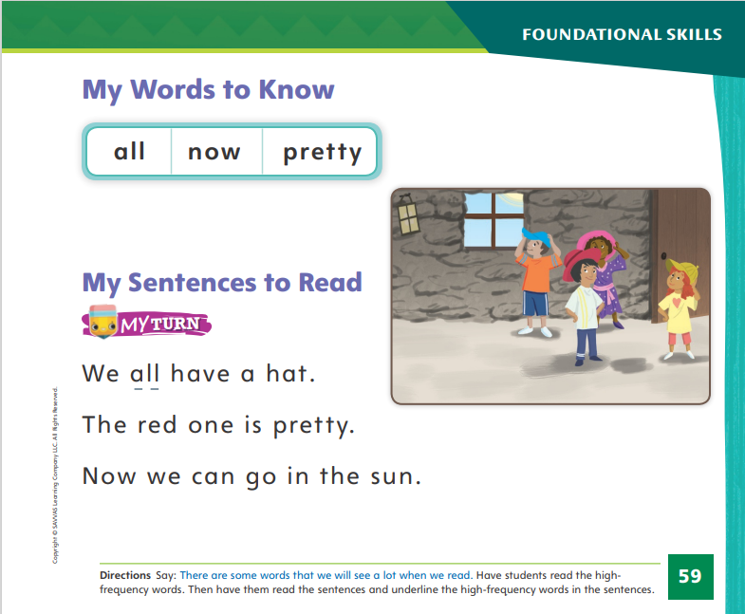
Page 59
High-Frequency Words
Turn to page 59 in your Student Interactive and complete the activity.
Notes:
Say: Today we will practice reading the high-frequency words all, now, and pretty.
Have students read the words at the top of p. 59 in the Student Interactive with you: all, now, pretty.
Have students look at the words at the top of p. 59. Say: I will read a word, and I want you to point to it. Then we will read the word together. Read all, and have students point to it. Now let’s read the word together: all. Repeat with the other words.
Have students read the sentences on p. 59 and underline the high-frequency word in each one.

Slide 39
Page 69
Find Main Idea and Supporting Details
Notes:
The central, or main, idea is what a text is mainly about. It is the big idea, not the small details, of a text.
Look at the title page of the text. Does it tell you what the main idea of the text is?
Look through the text. Does it contain illustrations that help you figure out the main idea?
You can find details in the text that help explain what the central, or main, idea of the text is.
Have students look at Uncovering the Past in the Student Interactive. Guide students to use the title as evidence to find the main idea. How does the title give clues about the text? Think about what the text is mainly about. Are there any details that support, or help show, the main idea?
Have students turn to the Close Read note on p. 77 of the Student Interactive and underline the words that tell the main idea of the text.

Slide 40
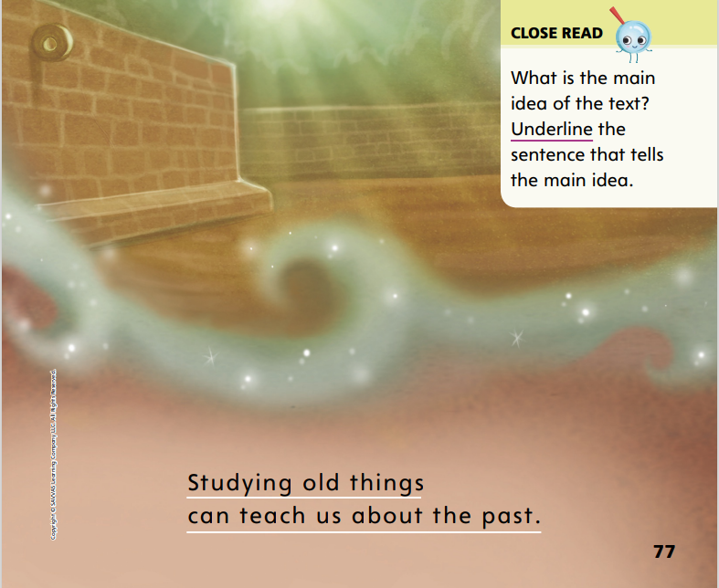
Page 77
Close Read – Find Main Idea and Supporting Details
Turn to page 77 in your Student Interactive.
Notes:
Remind students that the main idea in a text is the main thing the author wants to tell or teach the reader.
Read the Close Read note on p. 77 with students and guide them to find and underline the main idea of the selection. DOK 2

Slide 41
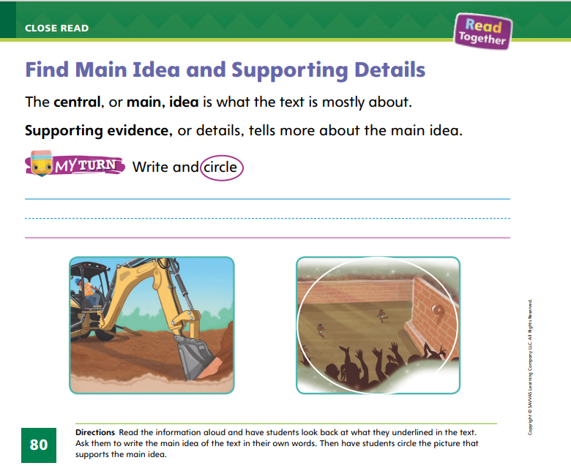
Page 80
Find Main Idea and Supporting Details
Turn to page 80 in your Student Interactive and complete the activity.
Notes:
Have students use the strategies for finding the main idea and supporting details of a text.
Have students complete p. 80 in the Student Interactive.

Slide 42
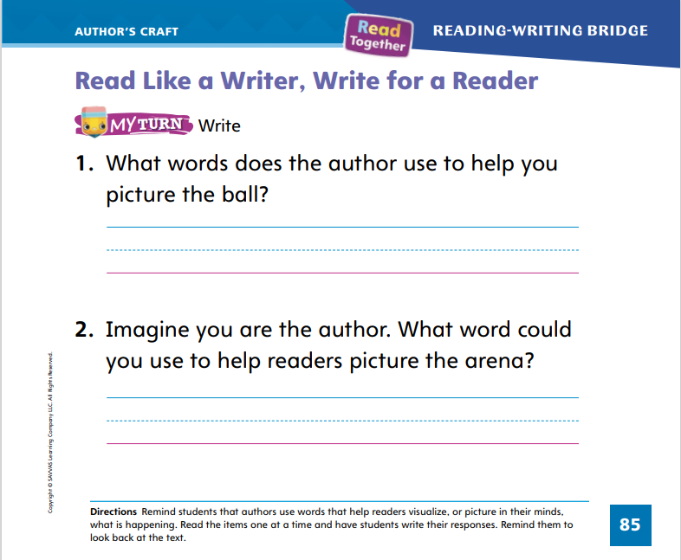
Page 85
Read Like a Writer, Write For a Reader
Turn to page 85 in your Student Interactive and complete the activity.
Notes:
Tell students that when they visualize, they create pictures in their minds of what is described in the text. Authors choose certain words that are vivid and interesting to help readers picture what they are reading.
Model how to visualize using the first question on p. 85 in the Student Interactive. The question asks us what word the author uses to tell about the ball. To find the word, I will need to look back in the text. On p. 75, the author describes the ball using the words black and rubber. Can you visualize the ball?
Find an item in the room and describe it while students have their eyes closed. Have them tell you the word or words that helped them visualize the object.
Have students complete p. 85 in the Student Interactive.

Slide 43
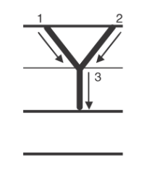
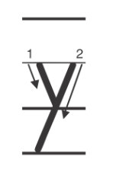
Handwriting
Notes:
Display the uppercase letter Y and the lowercase letter y.
Model how to write the uppercase letter Y by showing how the letter begins, what to do next, and then how to finish the letter. Repeat with lowercase y, calling students’ attention to the difference between the uppercase letter and the lowercase letter. Point out that lowercase y has a tail that dips below the line. Then have students practice forming the letters in the air.
Have students use Handwriting p. 203 from the Resource Download Center to practice writing Yy. Click path: Realize -> Table of Contents -> Resource Download Center -> Handwriting Practice -> U4W2L3 Handwriting Practice

Slide 44
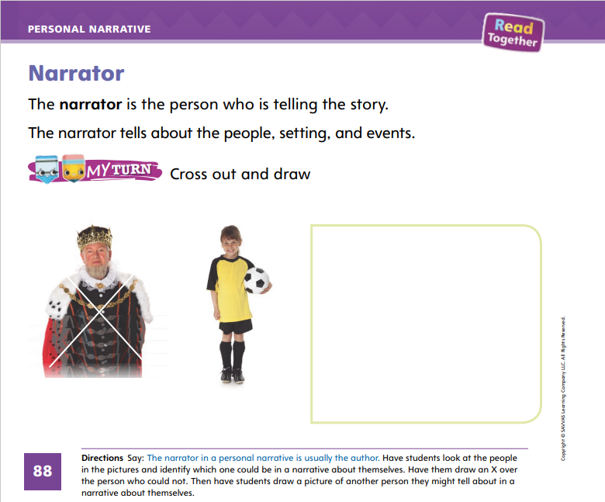
Page 88
Writing – Personal Narrative
Turn to page 88 in your Student Interactive and complete the activity.
Notes:
In a personal narrative, the author often narrates the story using words like I, me, and my. Another way for the author to narrate the story is by naming a main character and using words like he, him, and his.
Remind students that a personal narrative is a story about what happened in the author’s life. When the author writes a story based on a moment in his or her own life, that person is the narrator. Point out the name of an author on the cover of a stack text. Tell students that this person is the author, and he or she is also the narrator. Many writers of personal narratives write using words such as I, me, and my.
Next, hold up a stack text that is told in the third person. Read the author’s name on the cover, and tell students that the story they are about to read really happened to this person. Begin reading the book. Then tell students that some personal narratives do not include the words I, me, and my. In some books, the main character is referred to by name instead, but these books can still be personal narratives.
Direct students to p. 88 of the Student Interactive. Read the instructions at the top of the page, and complete the activity together.

Slide 45
Independent Writing
Review what you have written. Write your name on the front cover.
Share your personal narrative with class.
Discuss who the narrator is in each story.
Notes:
During independent writing time, have students review what they have written to be sure they are writing a story that has happened to them. Tell them that they should write their name on the front cover so readers know who the narrator is.
Writing Support
Modeled - Read stack books to identify the narrator.
Shared - Have students look through stack texts to identify the narrator of the story.
Guided - Prompt students to think of how the story would change if the narrator changed.
If they show understanding, have them continue writing their personal narratives.
Have one or two students share their personal narratives with the class. Tell students to discuss who the narrator is in each story.

Slide 46
Spelling
bun
cut
Notes:
Tell students that many CVC words have short vowels.
Write the word bun. I see this word has a CVC pattern. The u probably has a short vowel sound: /u/. This helps me spell the word. Say cut. Have students say each phoneme: /k/ /u/ /t/. Ask what vowel sound they hear. (/u/) Tell students cut has a CVC pattern. Have them write cut using what they know about letters, sounds, and vowel patterns.
Have students complete Spelling p. 211 from the Resource Download Center. Click path: Table of Contents -> Resource Download Center -> Spelling -> U4W2

Slide 47
Language and Convention
The boy opened the door.
Did you hear the bus honks its horn?
Oh no!
Notes:
Remind students of the three kinds of sentences: telling sentences that end with periods, questions that end with question marks, and exclamations that end with exclamation points.
To reinforce kinds of sentences, write two examples of each type of sentence on the board. Ask students to name the punctuation mark at the end of each sentence and identify each type of sentence.

Slide 48
Lesson 4

Slide 49
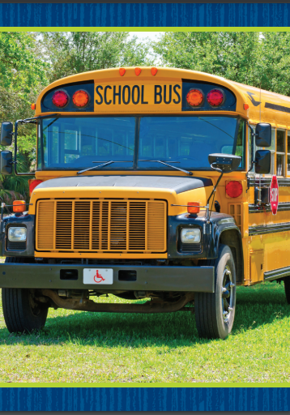
Page 60
Phonics
Uu
cub
rule
bus
June
mug
cute
Notes:
Hold up the bus Picture Card. This is a picture of a bus. I hear the sound /u/ in the middle of bus. Say the sound /u/ with me. Turn over the card and show students the spelling of the word. Point to the u and say the word bus. Do you hear the sound /u/? What letter spells the sound /u/? Have students identify the letter u.
Write the word cute on the board, and tell students the word is cute. I hear the sound /ū/ in the middle of cute. Say the word cute with me: /k/ /ū/ /t/. Point to the vowel pattern in cute and say /ū/. Do you hear the sound /ū/? What letters spell the sound /ū/? Have students identify u_e. Write Uu on the board. Have students trace the letters in the air as you write each letter on the board.
Have students turn to p. 60 in the Student Interactive. Let’s read the words on the page. We have learned all the letters and sounds of the words. Read them with me: /k/ /u/ /b/, /b/ /u/ /s/, /m/ /u/ /g/, /r/ /ū/ /l/, /j/ /ū/ /n/, /k/ /ū/ /t/. Have students read the words in the word bank.
Have students complete p. 60 in the Student Interactive.

Slide 50
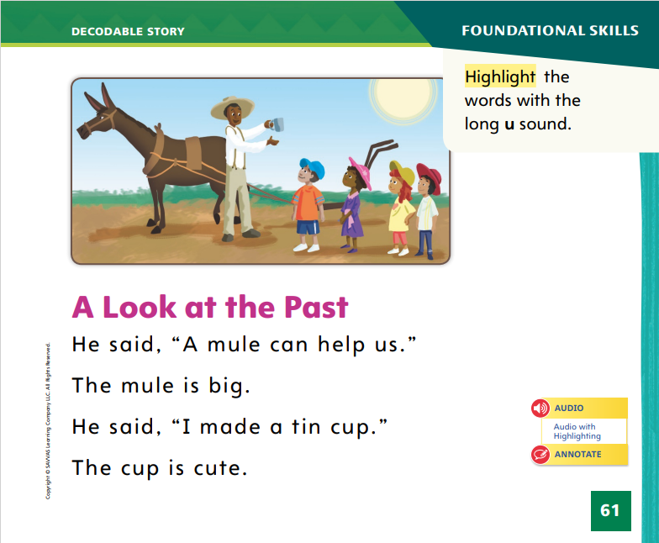
Page 61
Decodable Story
all
now
pretty
Turn to page 61 in your Student Interactive. We will Read “A Look at the Past.”
Notes:
Have students turn to p. 61 in the Student Interactive. We are going to read a story today about what life was like a long time ago. Point to the title of the story. The title of the story is A Look at the Past. In this story, we will read words that have sounds we have already learned, including /ū/ and /u/.
Remind students of this week’s high-frequency words: all, now, pretty. Tell them they will practice reading these words in the story A Look at the Past. Display the words. Have students read them with you. When you see these words in the story A Look at the Past, you will know how to identify and read them.
Have students whisper read the story as you listen in. Then have students reread the story page by page with a partner. Listen carefully as they use letter sound relationships to decode. Partners should reread the story. This time the other student begins.
After students have read the story, call their attention to the first sentence on p. 61 in the Student Interactive. I hear a word with the sound /ū/. I see the vowel pattern u_e in that word. What sound does the vowel pattern u_e spell? (/ū/) Help students find and highlight the word mule in the first sentence on p. 61. In the second sentence, I hear another word with the sound /ū/. Help students identify the word mule and highlight it. Continue the activity with the word cute in the last sentence on p. 61.

Slide 51
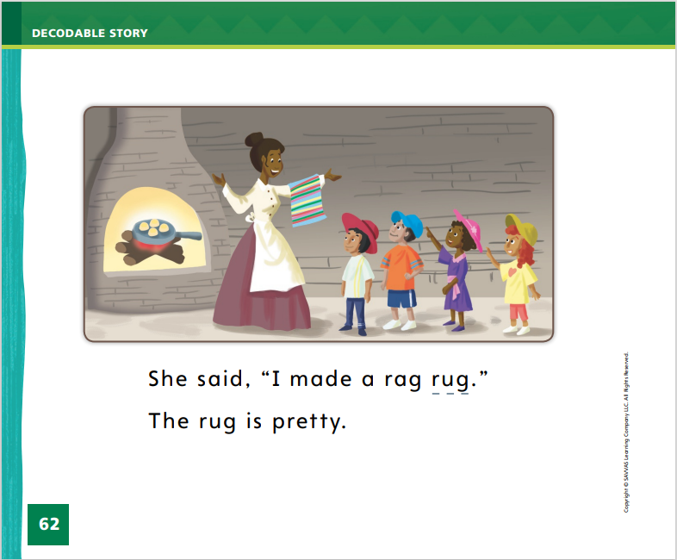
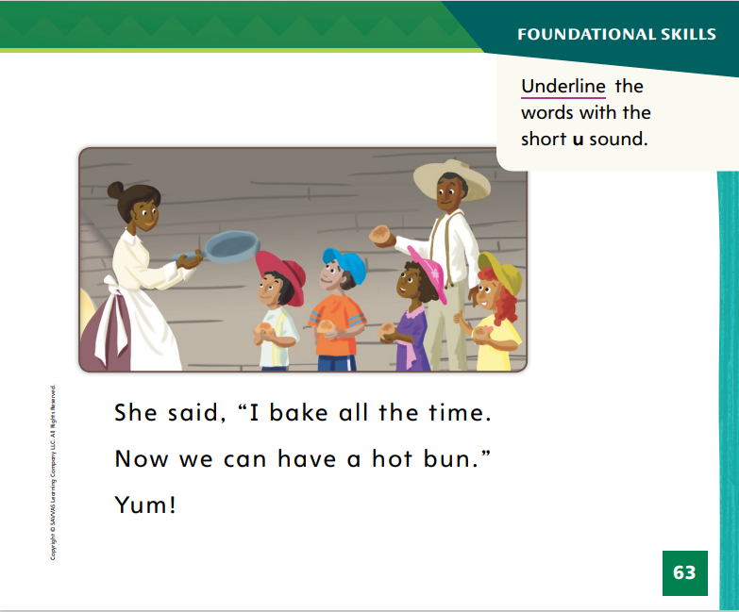
Page 62, 63
Decodable Story
Notes:
Have students turn to pp. 62–63. Which words include the sound /u/ spelled u? Point to them. Help students identify, or say, the words with the sound /u/ spelled u.
Then have students find and underline those words. Ask students to point to at least three high-frequency words they see, either from this week or a previous week.

Slide 52
Page 69
Make Inferences
Notes:
Tell students that they can use details in the text along with what they already know to make inferences. When you make an inference, you use information in a text to figure out something that is not said in the text.
What can I figure out from the text evidence, or the details in the text?
What do I already know about this topic?
What can I guess about the main idea from the information?
Say: Making inferences can help you better understand a text. When I make an inference, I use details in the text along with information I already know to see if I can figure out information that is not written in the text. Both words and pictures can be used to make inferences. Turn to page 71 in the Student Interactive. How did the workers feel when they hit stone? The workers were upset because they had to stop digging. How can you tell? They said, “Oh, no!” The text and picture help me figure out how the workers felt when they hit the stone wall.
Go back to the Close Read notes on pp. 71 and 73. Have students highlight the answers to the questions.

Slide 53
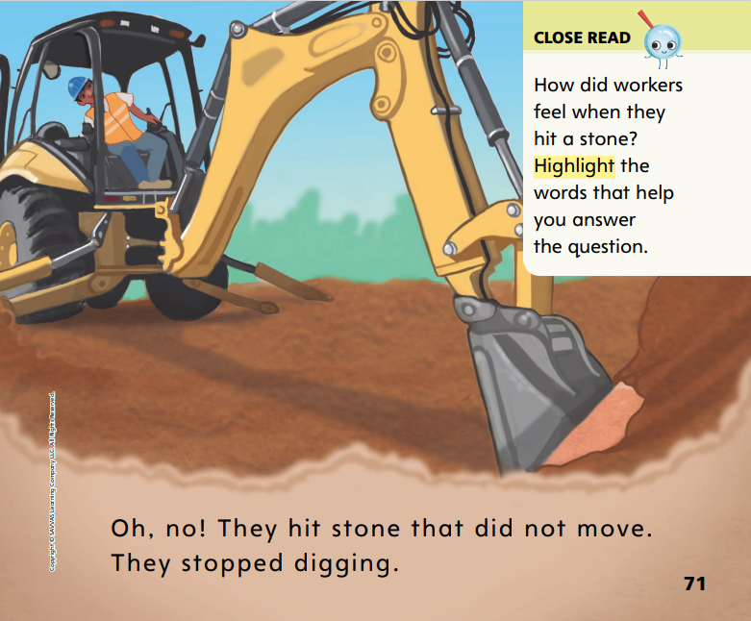
Page 71
Close Read – Make Inferences
Turn to page 71 in your Student Interactive.
Notes:
Ask students to read the Close Read note on p. 71. Point out that the text does not state how the workers felt, but that the reader can tell from the phrase "Oh, no!" Explain that they have to use their own knowledge of when they would use the phrase to figure out how the workers felt. This is making an inference. DOK 2

Slide 54
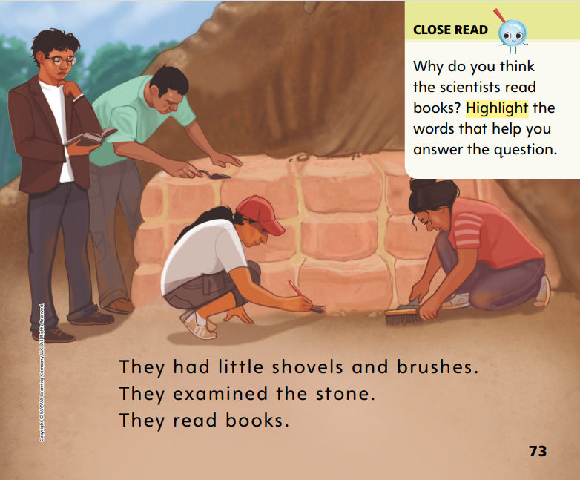
Page 73
Close Read – Make Inferences
Turn to page 73 in your Student Interactive.
Notes:
Read the Close Read note on p. 73 and have students find the sentence that helps them answer the question. DOK 2

Slide 55
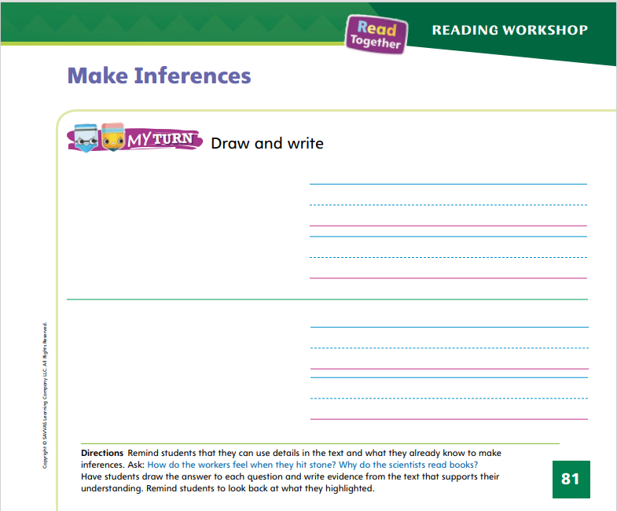
Page 81
Make Inferences
Turn to page 81 in your Student Interactive and complete the activity.
Notes:
Have students use the strategies for making inferences.
Have students complete p. 81 in the Student Interactive.

Slide 56
Writing – Personal Narrative
Plot
Notes:
The plot of a personal narrative consists of real-life events and actions that are important or memorable for the author. The plot often tells a real event or problem and how the author or narrator solved it.
Remind students that they are learning about personal narratives. Think aloud and write as you remember characteristics of a personal narrative. For example:
A personal narrative is a real story.
A personal narrative tells what happened in the author’s life.
A personal narrative has a real-life setting and characters.
Next, think aloud and write as you remember elements of a plot. For example:
A plot of a story tells events in order.
A plot has a problem and resolution.
Read or reread a stack book. Tell students that the plot of the story tells events in order. Ask students to tell you what happened first in the book. Then ask what happened next. Continue retelling the plot together. When you write your own personal narratives, you will write the events in the order they happened.

Slide 57
Independent Writing
Review your narrative to be sure the events are in order and no important events are missing.
Share your personal narrative with the class.
Notes:
After this lesson, students should transition into independent writing and conferences. Have them review what they have written to be sure the events are told in order and no important events are missing.
Writing Support
Modeled - Use stack texts to identify the problem and resolution of a story.
Shared - Encourage students to think about their favorite book and identify the challenge the character faced and how he or she resolved it.
Guided - Prompt students to identify the events of their plot, including the problem and resolution.
Have a student share his or her personal narrative. Call on other students to retell the plot, one event at a time.

Slide 58
Spelling
hop
box
mop
dot
Notes:
Write the word hop. Point out the CVC pattern and explain that the vowel probably has the short sound. Ask them what sound the vowel spells in this word. (/o/)
Say the word hop. I hear short o in hop: /o/. I hear one consonant at the beginning and one at the end. I can spell this CVC word. Write the word. Then say the following words and ask students to spell them: box, mop, dot.
Have pairs spell other CVC words. Have students focus on words in the -op, -ox, and -ot word families (examples: pop, top; fox; cot, lot, not).

Slide 59
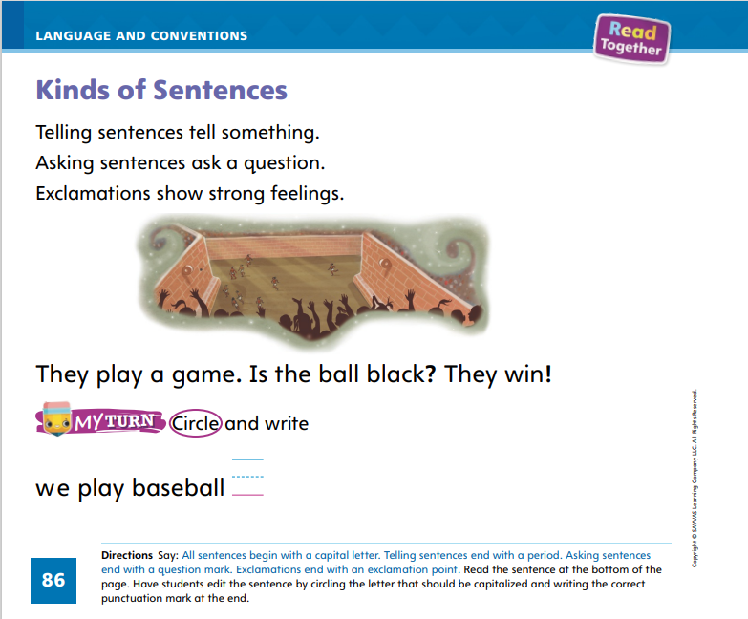
Page 86
Language and Conventions
Turn to page 86 in your Student Interactive and complete the activity.
Notes:
Have students edit for punctuation and capitalization in declarative sentences on p. 86 in the Student Interactive.

Slide 60
Lesson 5

Slide 61
Phonological Awareness
Winter
Background
Notebook
Playful
Singer
Sunshine
How many syllables are in each word?
Notes:
Tell students: Today we are going to talk about syllables, or word parts. Listen carefully as I say this word: winter. How many syllables are in the word win (clap) ter (clap)? Yes, there are two. What is the first syllable in winter? Students should say win. What is the second syllable in winter? Students should say ter.
Listen carefully as I say this word: notebook. How many syllables are in note (clap) book (clap)? Yes, there are two. What is the first syllable in notebook? Students should say note. What is the second syllable in notebook? Students should say book.
Say the word singer as you clap the syllables. Ask students how many syllables they hear in singer. Then ask them to say the first and last syllable. Continue the activity with background, playful, and sunshine.

Slide 62
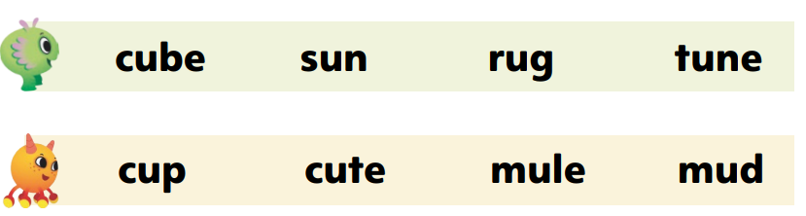
Page 64
Phonics
u
u_e
June
Turn to page 64 in your Student Interactive and read the words.
Notes:
Write the letter u and the vowel pattern u_e on the board. Have students identify the letters as you point to them and say the sounds they make.
Tape a u or u_e card on each student. Gather students into a circle. Write the word June on the board. We will read this word together. If you have a u and hear the sound /u/, touch your toes. If you have a u_e and hear the sound /ū/, stand on one foot. Point to each letter as you read the word aloud. Let’s read this word together: /j/ /ū/ /n/, June. This word has the sound /ū/, so some of you should be standing on one foot! Continue the activity with these words: lug, tune, mule, rule, fun, mug, tub, cute, sun, huge, bun.
Have students turn to p. 64 in the Student Interactive and read the words with a partner. Have them draw a picture showing one of the words.

Slide 63
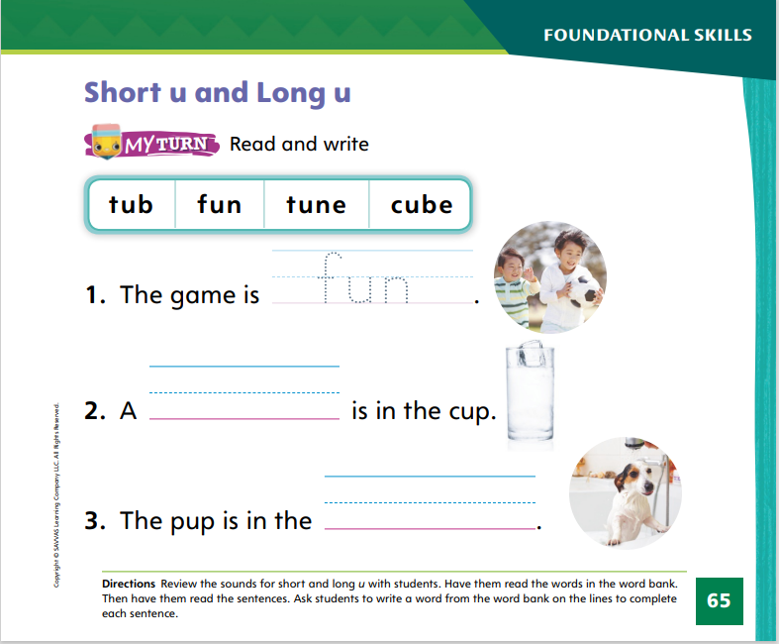
Page 65
Apply
Turn to page 65 in your Student Interactive and complete the activity.
Notes:
Have students look at p. 65 in the Student Interactive. Have them complete the sentences with words from the word bank.
Then guide them as they read the sentences.

Slide 64
High-Frequency Words
pretty
all
now
Notes:
Remind students that high frequency words are words that appear over and over in texts. Remind them that they will be learning many of the words this year, and the words will help them become better readers.
Say the word pretty and ask students what letters spell the word.
Have students
say each letter as you write it on the board.
say and spell the word.
repeat with all and now.

Slide 65
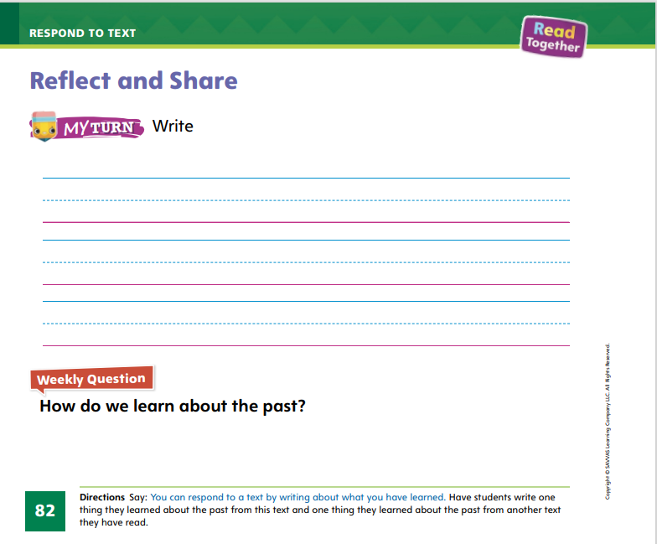
Page 82
Reflect and Share
Turn to p. 82 in your Student Interactive and complete the activity.
Notes:
Tell students that different texts can teach them different things about the past. Tell them different texts also show different ways that people learn about the past—reading books, going to museums, and so on.
Have students think about the main idea of the texts they are comparing.
Have them find supporting details from the texts.
Have them identify the details that are facts about the past.
Model making a connection between the information about the past found in two different texts: Cars Are Always Changing and Uncovering the Past. In Uncovering the Past, I learned that the Mayans used to play sports. And, in Cars Are Always Changing, I learned that cars used to be much slower. Both of these things are details, or information, about the past.
Have students complete p. 82 in the Student Interactive. Remind them to include details from the text to support their ideas.

Slide 66

Page 82
Apply
How do we learn about the past?
Discuss your answer with your group.
Notes:
Have students use evidence from the text they have read this week to respond to the Weekly Question.
Tell them to discuss their answers in small groups.

Slide 67
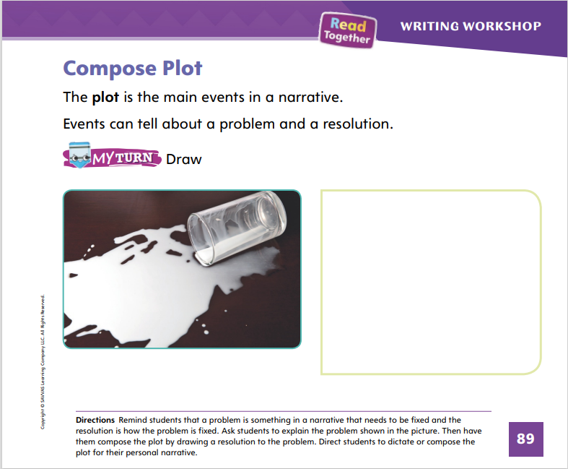
Page 89
Writing – Personal Narrative
Turn to page 89 in your Student Interactive.
Notes:
As authors compose the plot of their personal narratives, they organize the events in a sequence of how things happened. Authors use sequence words, such as first, next, and last, when writing the plots of their personal narratives. An author also includes a problem and a resolution.
Choose an event that may have happened to you that students can relate to, such as falling off your bike. Tell students the story, for example: I was riding my new green bike on the sidewalk. First, I noticed that I was going very fast. Next, I pushed the handbrake to stop, and the bike stopped. Then I tried touching the ground with my feet but I couldn’t reach, and I fell. Luckily I was not hurt. Last, I told my mom to lower the seat so I wouldn’t fall next time. Ask students to name the problem (the bike seat was too high) and the resolution (my mom lowered the seat).
Now retell the story using the same sequence of events, drawing pictures to show your story. Make sure to think aloud as you draw details in the setting and characters. For example: It was a sunny day, so I will draw the sun. I remember there were trees and bushes, so I will draw those in my setting. At the end of my story, I am happy, so I will draw a smile on my face. Tell students that they can write their story using both words and pictures.
Direct students to dictate or compose plot on p. 89 of the Student Interactive.
Have a few students share their stories with the class. Prompt students to identify the problem and resolution in their stories. Tell students to talk about why they chose this problem and resolution.

Slide 68
Spelling
I got a new rug for my room.
Our family trip was so much fun.
I ate all of the strawberries.
We need a cup of water for the recipe.
Mom said to clean my room right now.
I can go to the park, but I have to be home for dinner.
Notes:
(Note: Move the orange boxes to cover each bold spelling word before you read aloud the words and sentences.)
Read aloud the words and sentences. Have students spell each word with initial consonant blends and the two high-frequency words.
I got a new rug for my room.
Our family trip was so much fun.
I ate all of the strawberries.
We need a cup of water for the recipe.
Mom said to clean my room right now.
I can go to the park, but I have to be home for dinner.
Reveal the spelling word and have students check their work.

Slide 69
Language and Conventions
Which sentence ends in a question mark?
Jill likes to read.
What book is Jill reading?
What a great book!
It is fun to read.
Notes:
Guide students to complete the question.
Which sentence ends in a question mark?
Jill likes to read.
What book is Jill reading?
What a great book!
It is fun to read.
Have students complete Language and Conventions, p. 217 from the Resource Download Center. Click path: Table of Contents -> Resource Download Center -> Language and Conventions -> U4 W2

Slide 70
Unit 4: Week 2
Grade K

